Slide 1
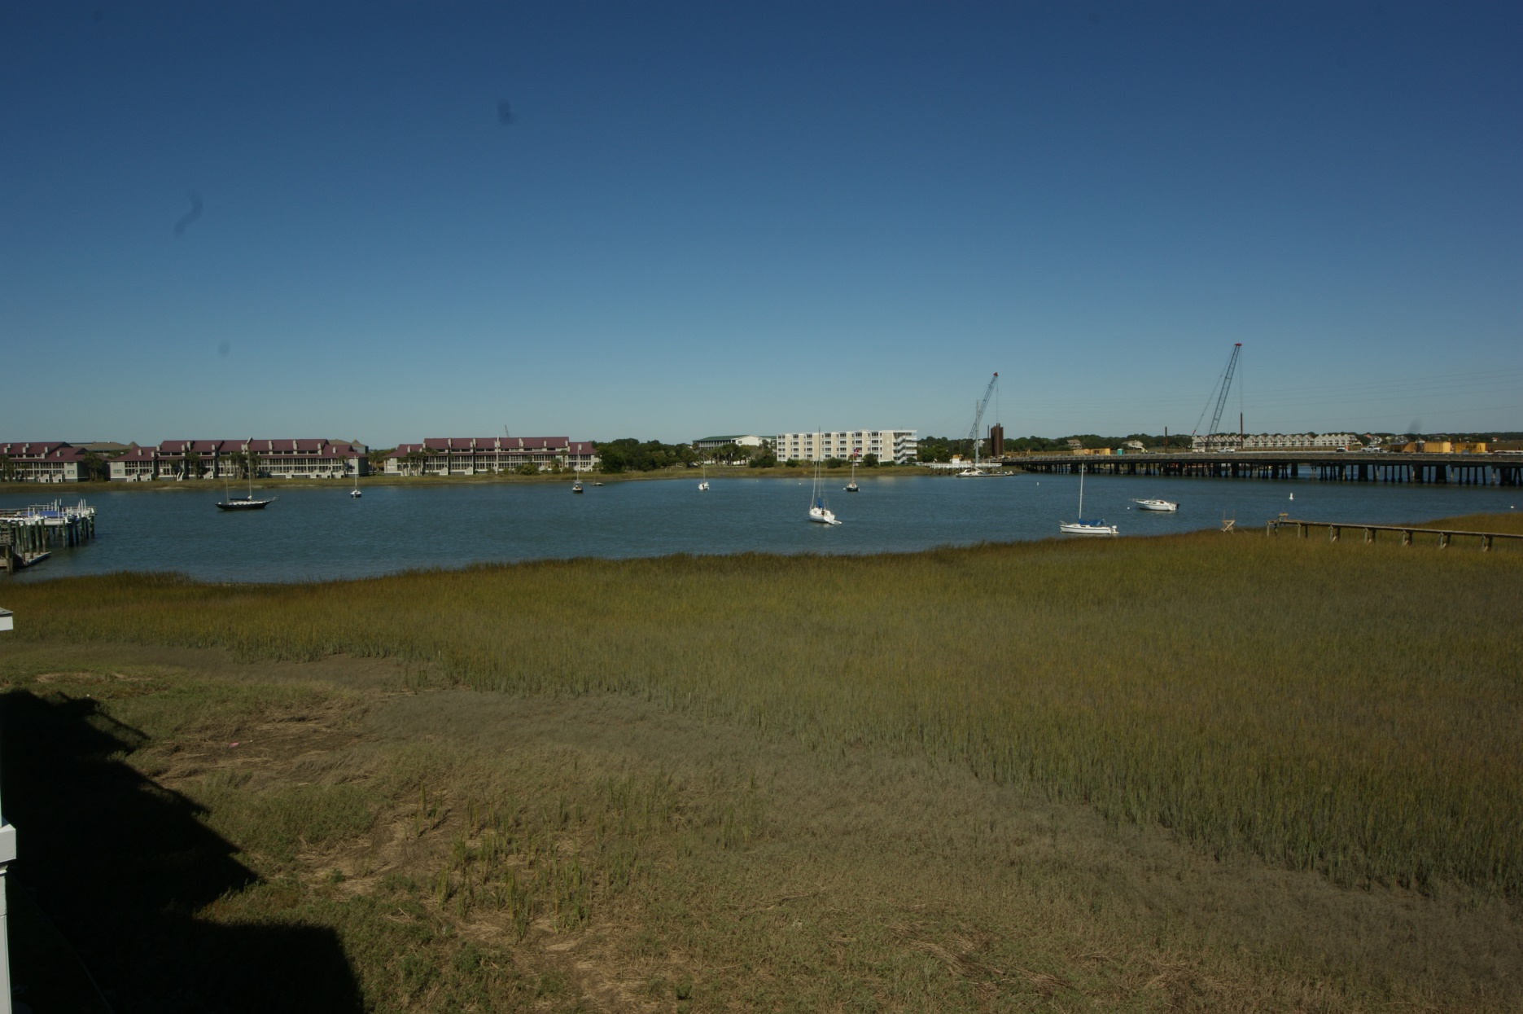
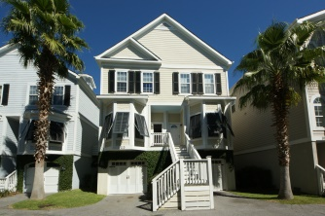
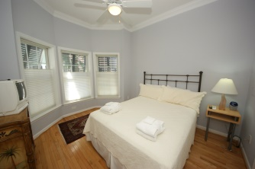
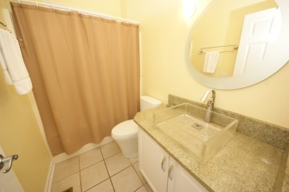
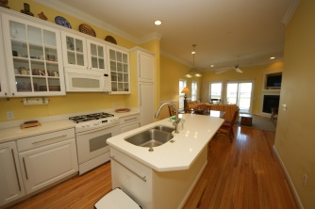
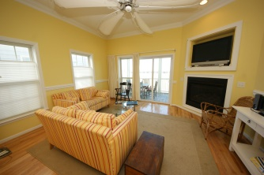
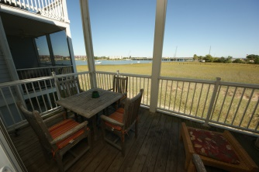
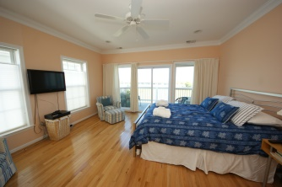

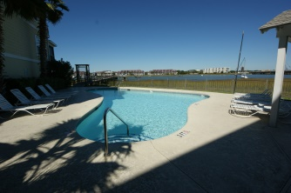
If you’re looking for a Lowcountry home with contemporary qualities, this may be it.
110 2nd St
Waters Edge :: Folly Beach
MLS# 14027839
$549,000
Wonderful River views at Folly Beach
Waters Edge condo, just a few minutes from historic city of Charleston, SC. Great views from screened porch and private balcony upstairs of the Folly River and Bridge onto Folly Beach. Waters Edge has a swimming pool and a community dock. You can walk or bike to the many Folly Beach restaurants and shops. The kitchen features quartz counter tops, high end appliances. The kitchen opens to the dining area and spacious family room. There is a bedroom on the main floor with a full size bathroom that could be used as a master bedroom. Upstairs has a master bedroom with access to a balcony overlooking the Folly River. The master bathroom has double sink vanities; separate tub and shower and a large walk in closet. 3rd bedroom is currently being used as an office with a built-in desk and a built in Murphy Bed! with a bathroom en suite. All closets have been professionally designed by California Closets and whole house has hardwood floors and bathrooms have ceramic tile for flooring. Edge is perfect as a primary home, a vacation home or a rental property. HOA fees include flood, hazard, wind and hail insurance, common area maintenance, and pest control. Plus this town home has working hurricane shutters. Please note home is in process of being completely painted with color repose gray.
Karla Leahy
Realtor CRP, ASP, QSR
karlaleahy@gmail.com | (M) 843-452-6670
www.yourlowcountryproperties.com
Harbor City Real Estate Advisors | 510 Live Oak Drive | Mt Pleasant SC 29464

