Slide 1
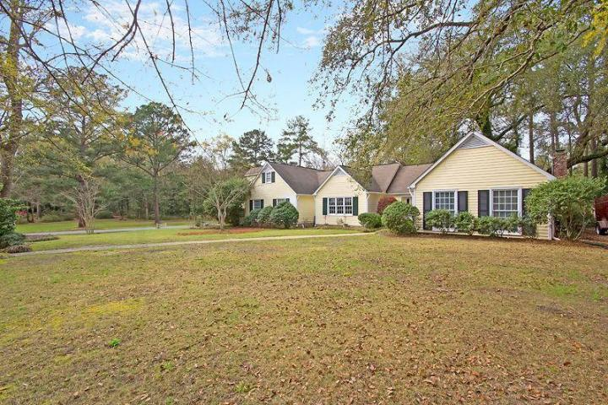
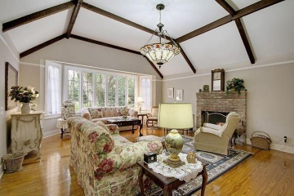
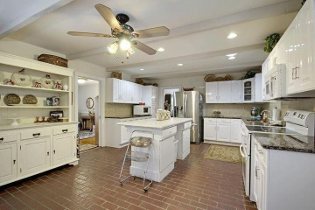
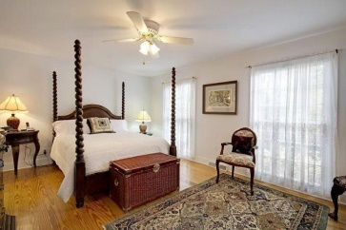
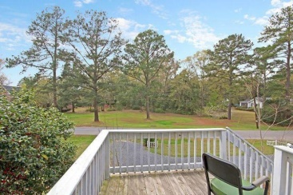
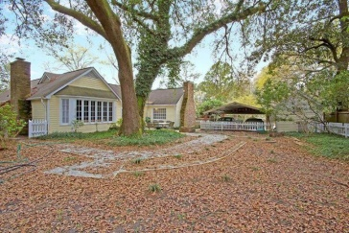


In-Town Country Club Estate
111 W Walker Drive
Tea Farm
Summerville
MLS# 15008010
$369,000
Welcome To The Historic ''Tea Farm Plantation''
This Incredible fully detached sprawling ranch style home is situated on a quiet tree-lined street and is surrounded by a Valuable .6 acre private, landscaped yard.
This Remarkable home offers beautiful wood flooring and has 4 large bedrooms including the spacious master bedroom suite with a private master bathroom and huge walk-in closet.
The traditional floor plan includes the classic family room with a cozy fireplace, the charming formal dining room, the beautiful formal living room, the modern family sized country kitchen with genuine solid brick flooring, selected granite counter tops, upgraded built-in appliances, an authentic brick fireplace and crafted wood cabinets.
There is a private walk-out to the popular oversized deck that is perfect for outside cook-outs and entertaining. There is a private/secret room that is perfect for a private man cave, office or in-law suite and can be accessed from the private exterior entrance.
Come and discover this unique home that offers the best of both worlds, Classic workmanship and modern conveniences. Age, sqft, taxes, schools & acreage are approx. buyer to verify.
Bill Everett, Jr
Broker
Office 843-767-7777
Direct 843-693-8539
Fax 843-576-5352
RE/MAX Pro Realty, 9209 University Blvd, Charleston, SC 29406

