Slide 1
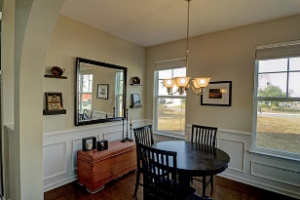
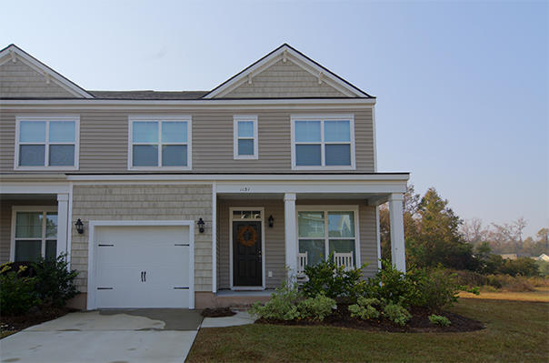
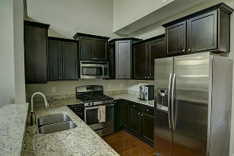
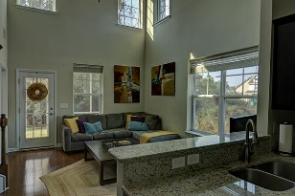
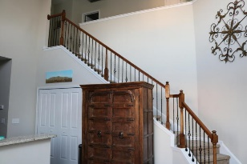
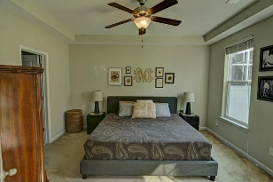
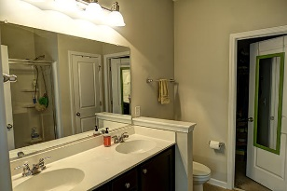
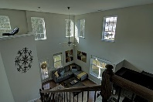
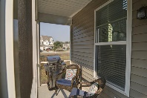
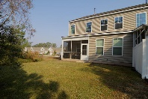


1131 St Pauls Parrish Ln
Price Reduced in The Gates of Fenwick Plantation
The Gates of Fenwick Plantation
Johns Island, SC 29455
MLS# 16029667
$225,000
Immaculate end unit townhome with 3 bedrooms, 2 1/2 baths PLUS loft which can easily be turned into 4th bedroom. All bedrooms have spacious walk-in closets. Lots of natural light and very high ceilings. Gorgeous kitchen with granite counters, custom cabinetry, and upgraded stainless gas range. Open floorplan from living area to kitchen with separate dining. Beautiful wood floors, ceramic tile, crown molding and wainscoting. You will love the custom wrought iron stair railing. Tankless water heater and private screened back porch with gas connection for your BBQ's. There is a large green space next door for extra privacy. You will enjoy the landscaped ponds, sidewalks and neighborhood pool. This property has it all!
Stephanie Deaton M – 843-743-4219
O – 843-769-5100
stephanie.deaton@agentownedrealty.com

