Slide 1

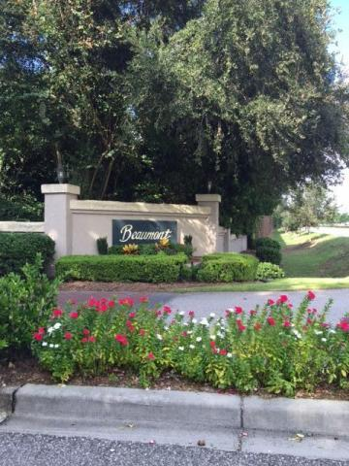
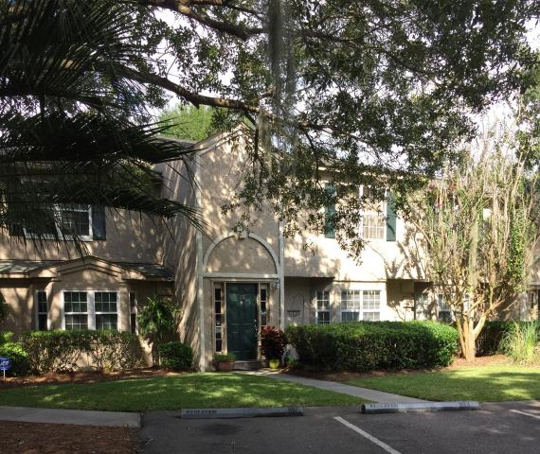
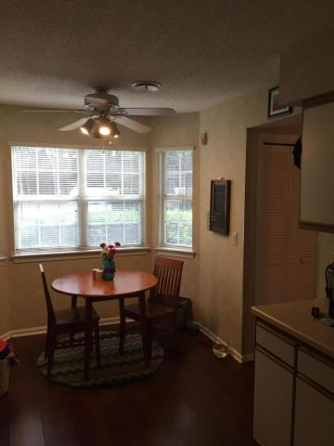
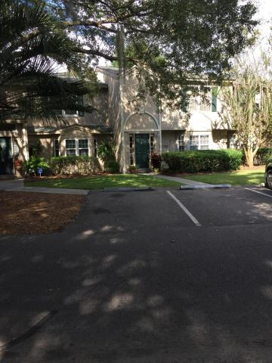
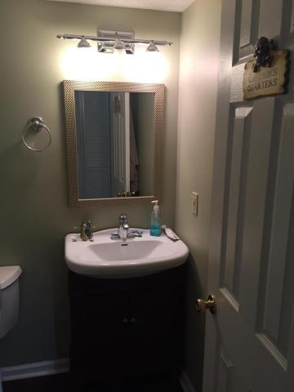

Minutes to beaches and walk to Towne Center
1155 Monaco Drive
Beaumont ~ Mount Pleasant, SC 29464
MLS# 16024957 ~ $212,000
Centrally located townhouse 5 min from beach and 10 min to downtown Charleston.
Spacious unit with wall to wall carpet upstairs and bamboo flooring on the first floor.
Fenced in yard with extra privacy that backs up to common area park.
Amenities include clubhouse, pool, and fitness center.
Andrew Tackitt
843-437-8726 cell
andrew@radekopf.com
1205 Two Island Court, Suite 201 | Mount Pleasant, SC 29466
Phone: (843) 579.2217 | Fax: (843) 971-0281

