Slide 1
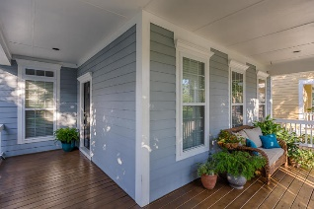
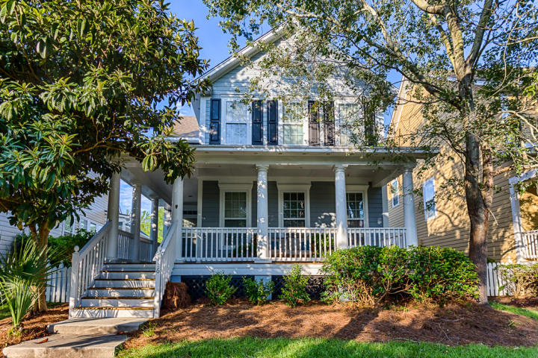
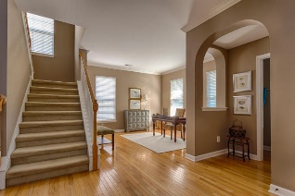
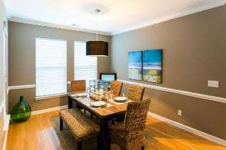
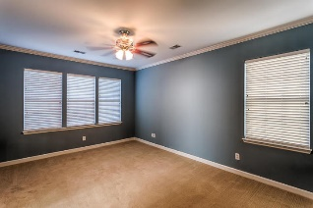
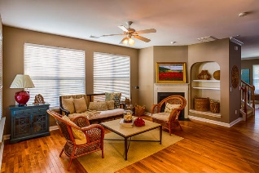
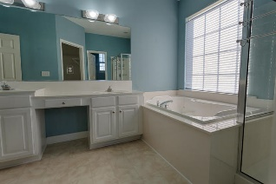
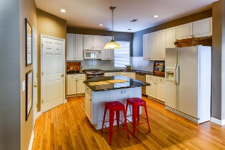
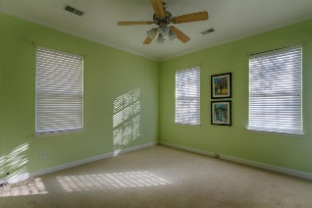
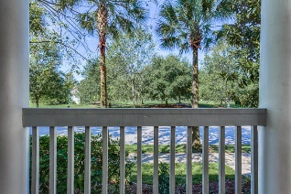
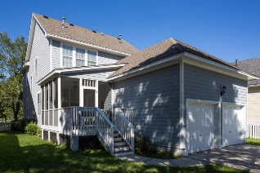
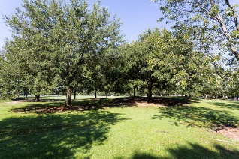
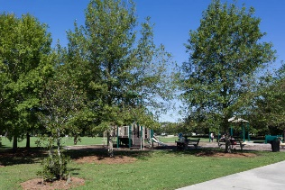
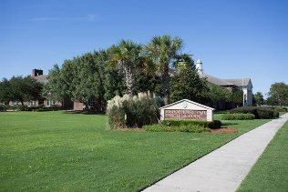


116 Etiwan Park Street Charleston, SC 29492 - MLS# 16023594 - $539,000
Outstanding Opportunity on Daniel Island!
Lovely Lowcountry home nestled amid mature trees and located on a gracious tree-lined street, this home invites you to come and relax on the wide wrap- around porch with the soft breezes and enjoy the beauty of the island. Directly across from a beautiful seven acre park, this setting is a fitting introduction to a warm and welcoming interior. First impressions are important! Enter through the front door into the inviting foyer which opens into a bright open floor plan flowing seamlessly into the dining room and living room/ office. Attention to detail is evident in the crown molding, fresh paint, graceful arch, and hardwood floors which span the downstairs of this lovely floor plan.
And that’s just for starters…there are so many more highlights!
Peggy Leete Office - (843) 884-1622
Cell - (843) 532-7923
pleete@carolinaone.com
www.peggyleetehomes.com
Carolina One Real Estate
628 Long Point Rd
Mt Pleasant, SC 29464

