Slide 1
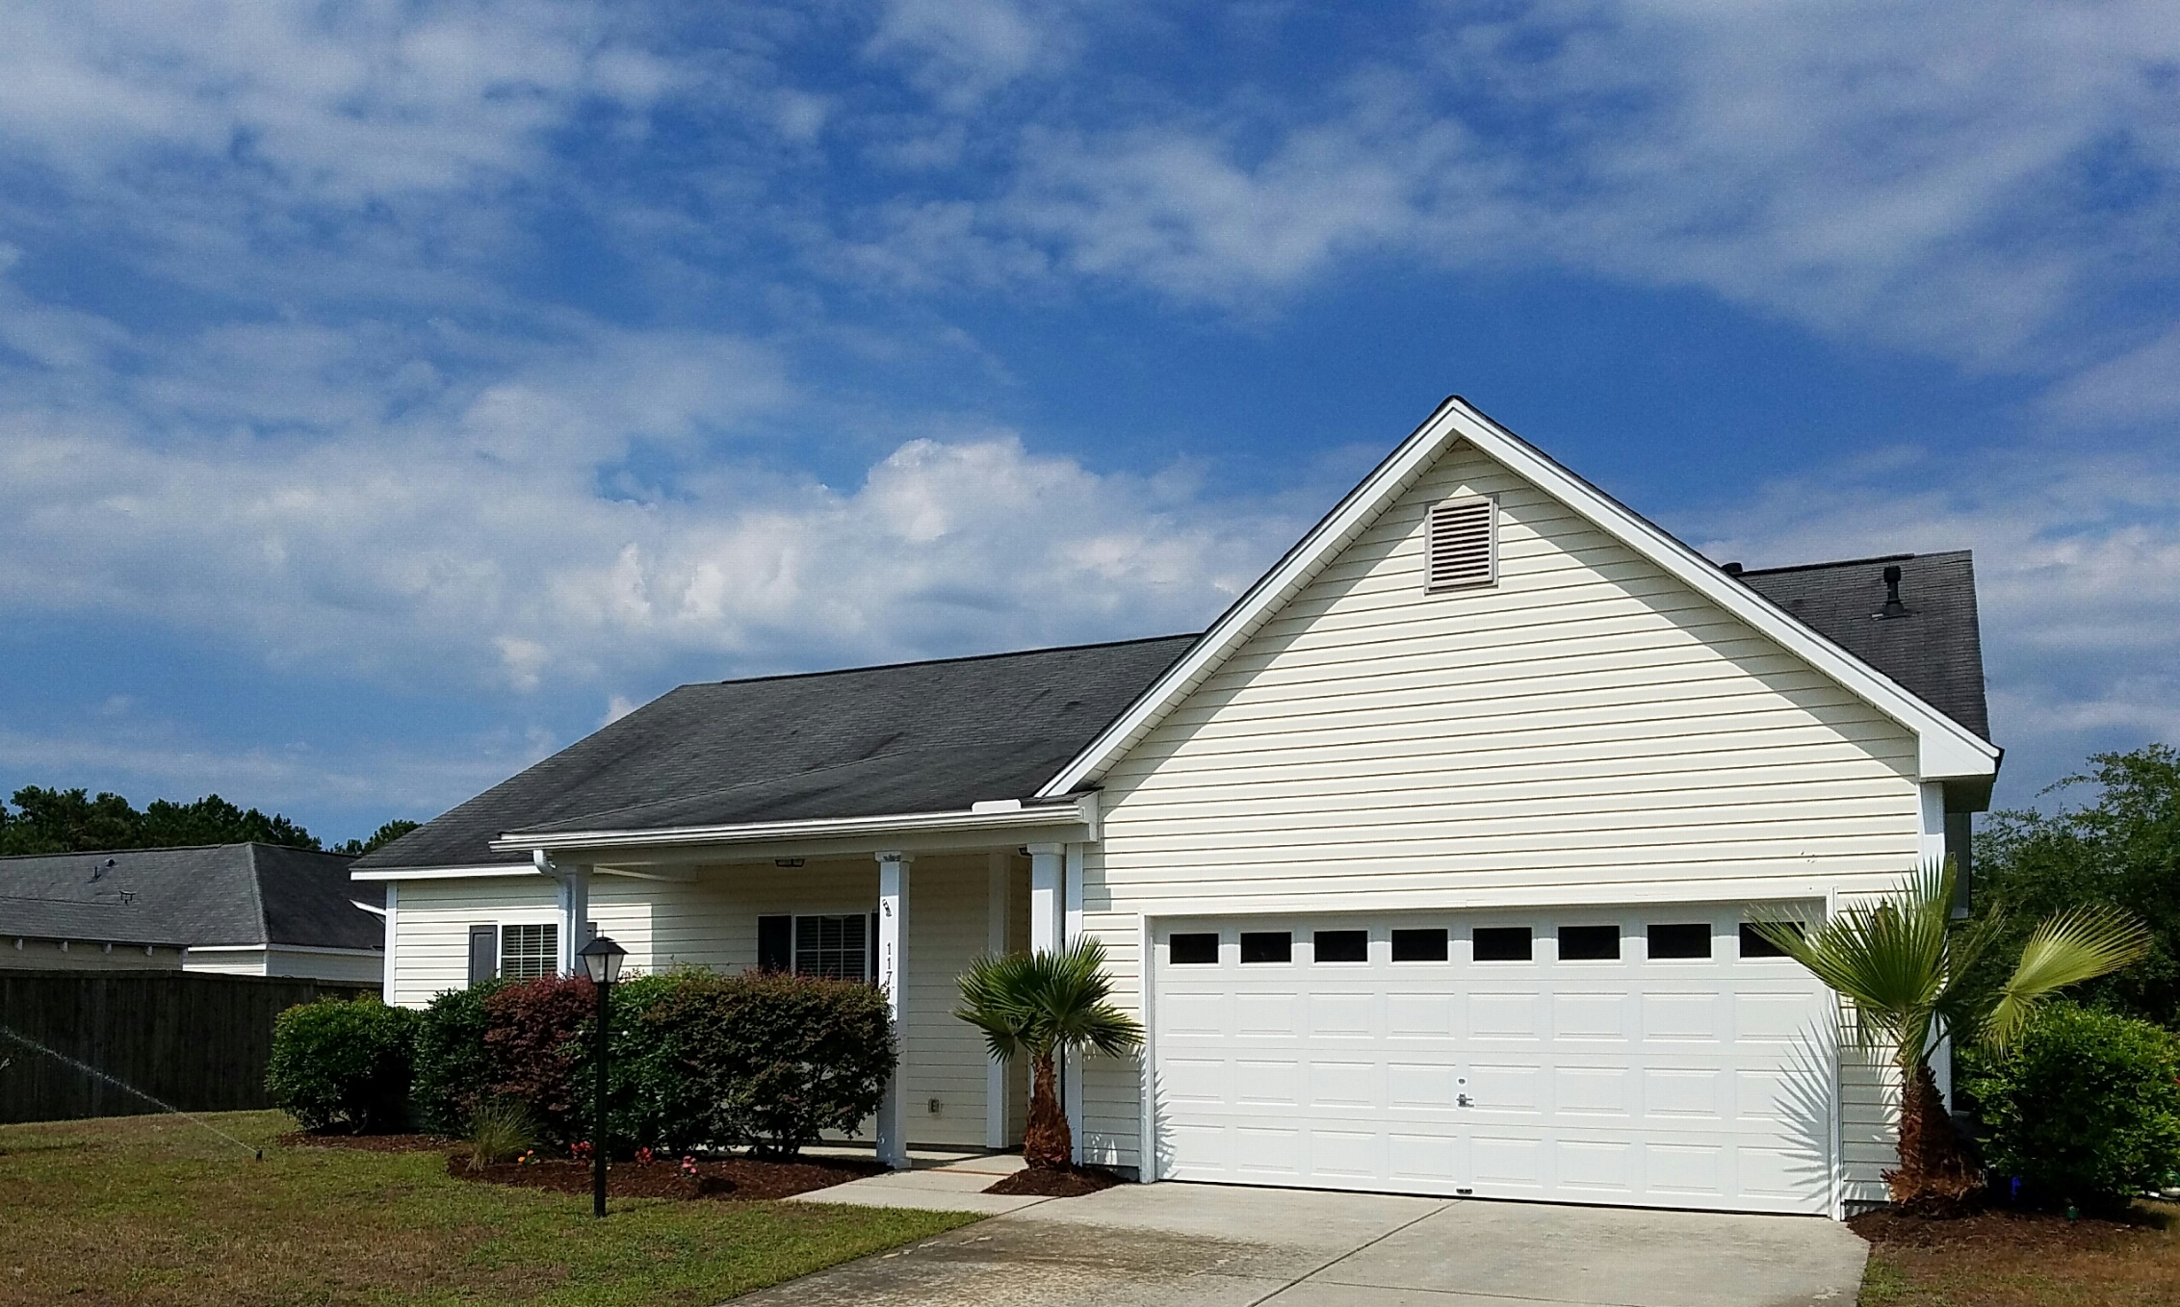
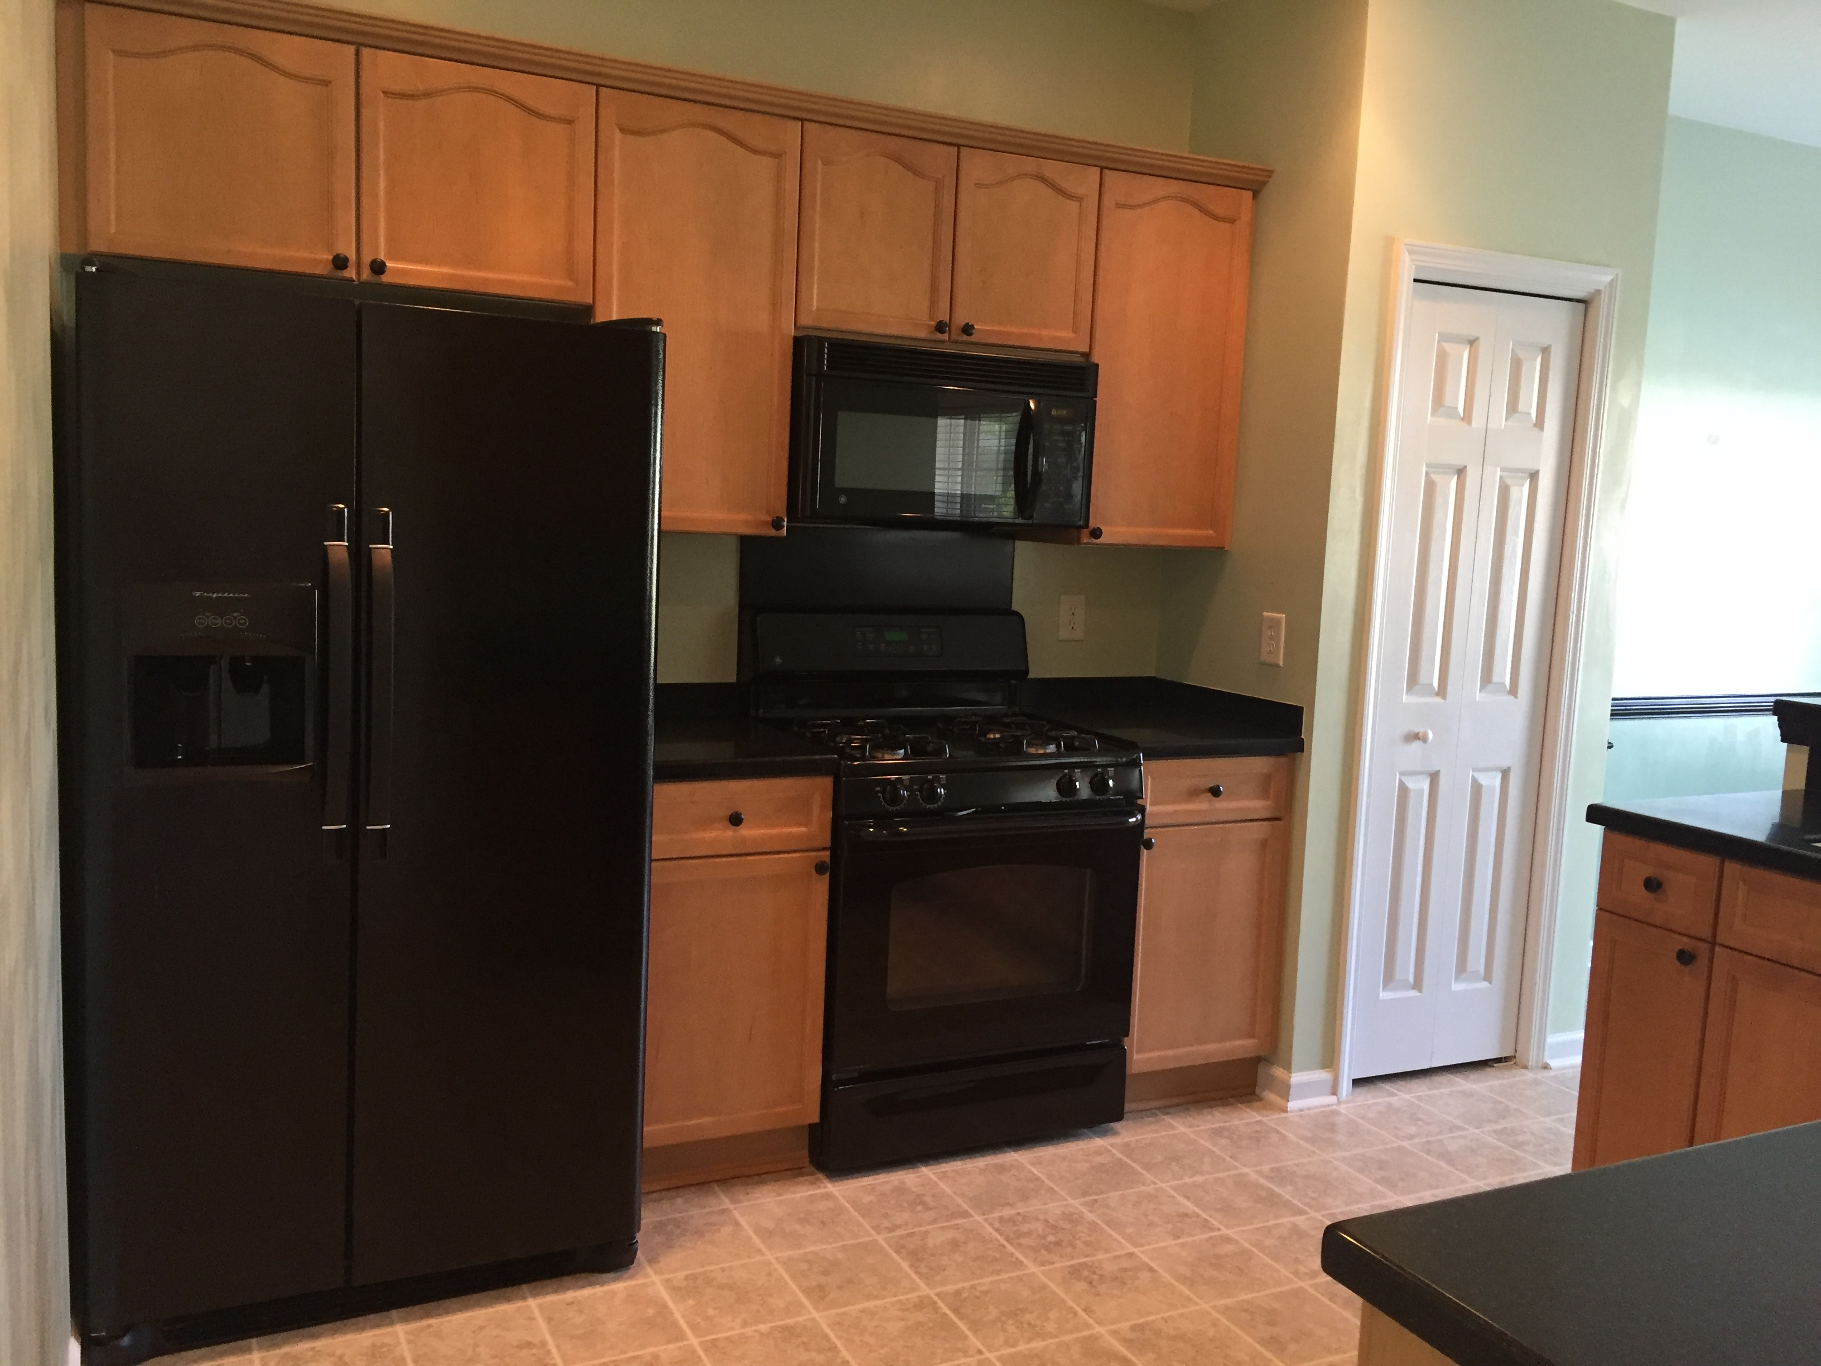
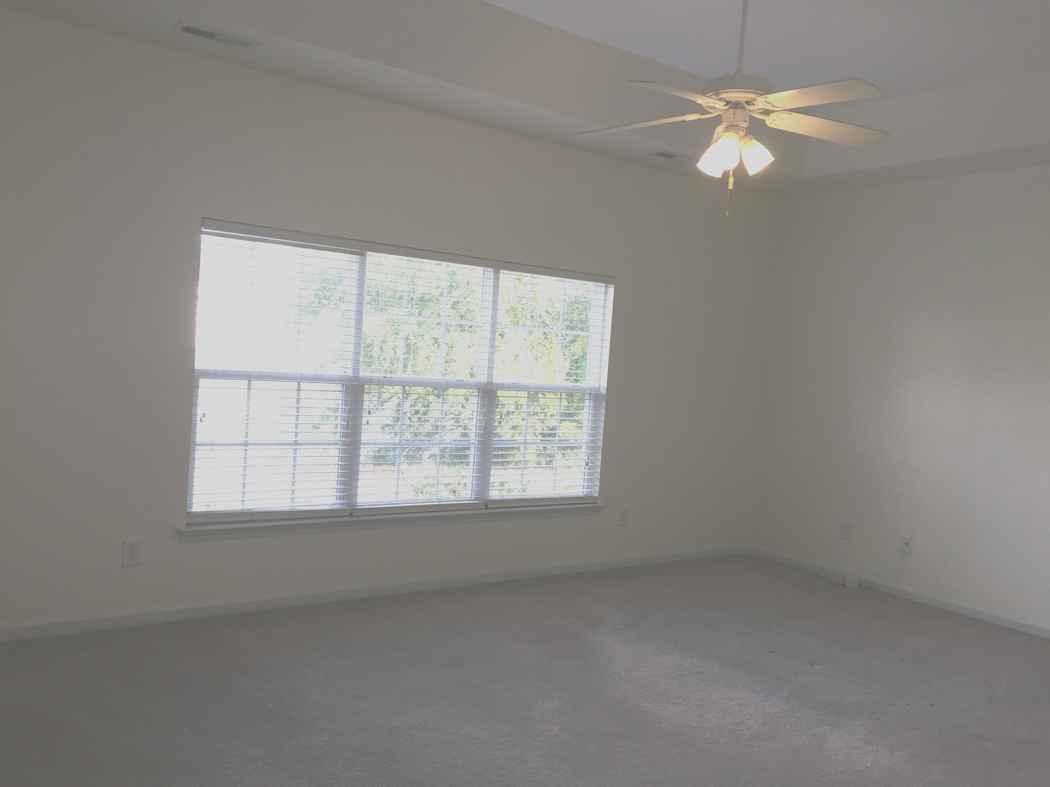
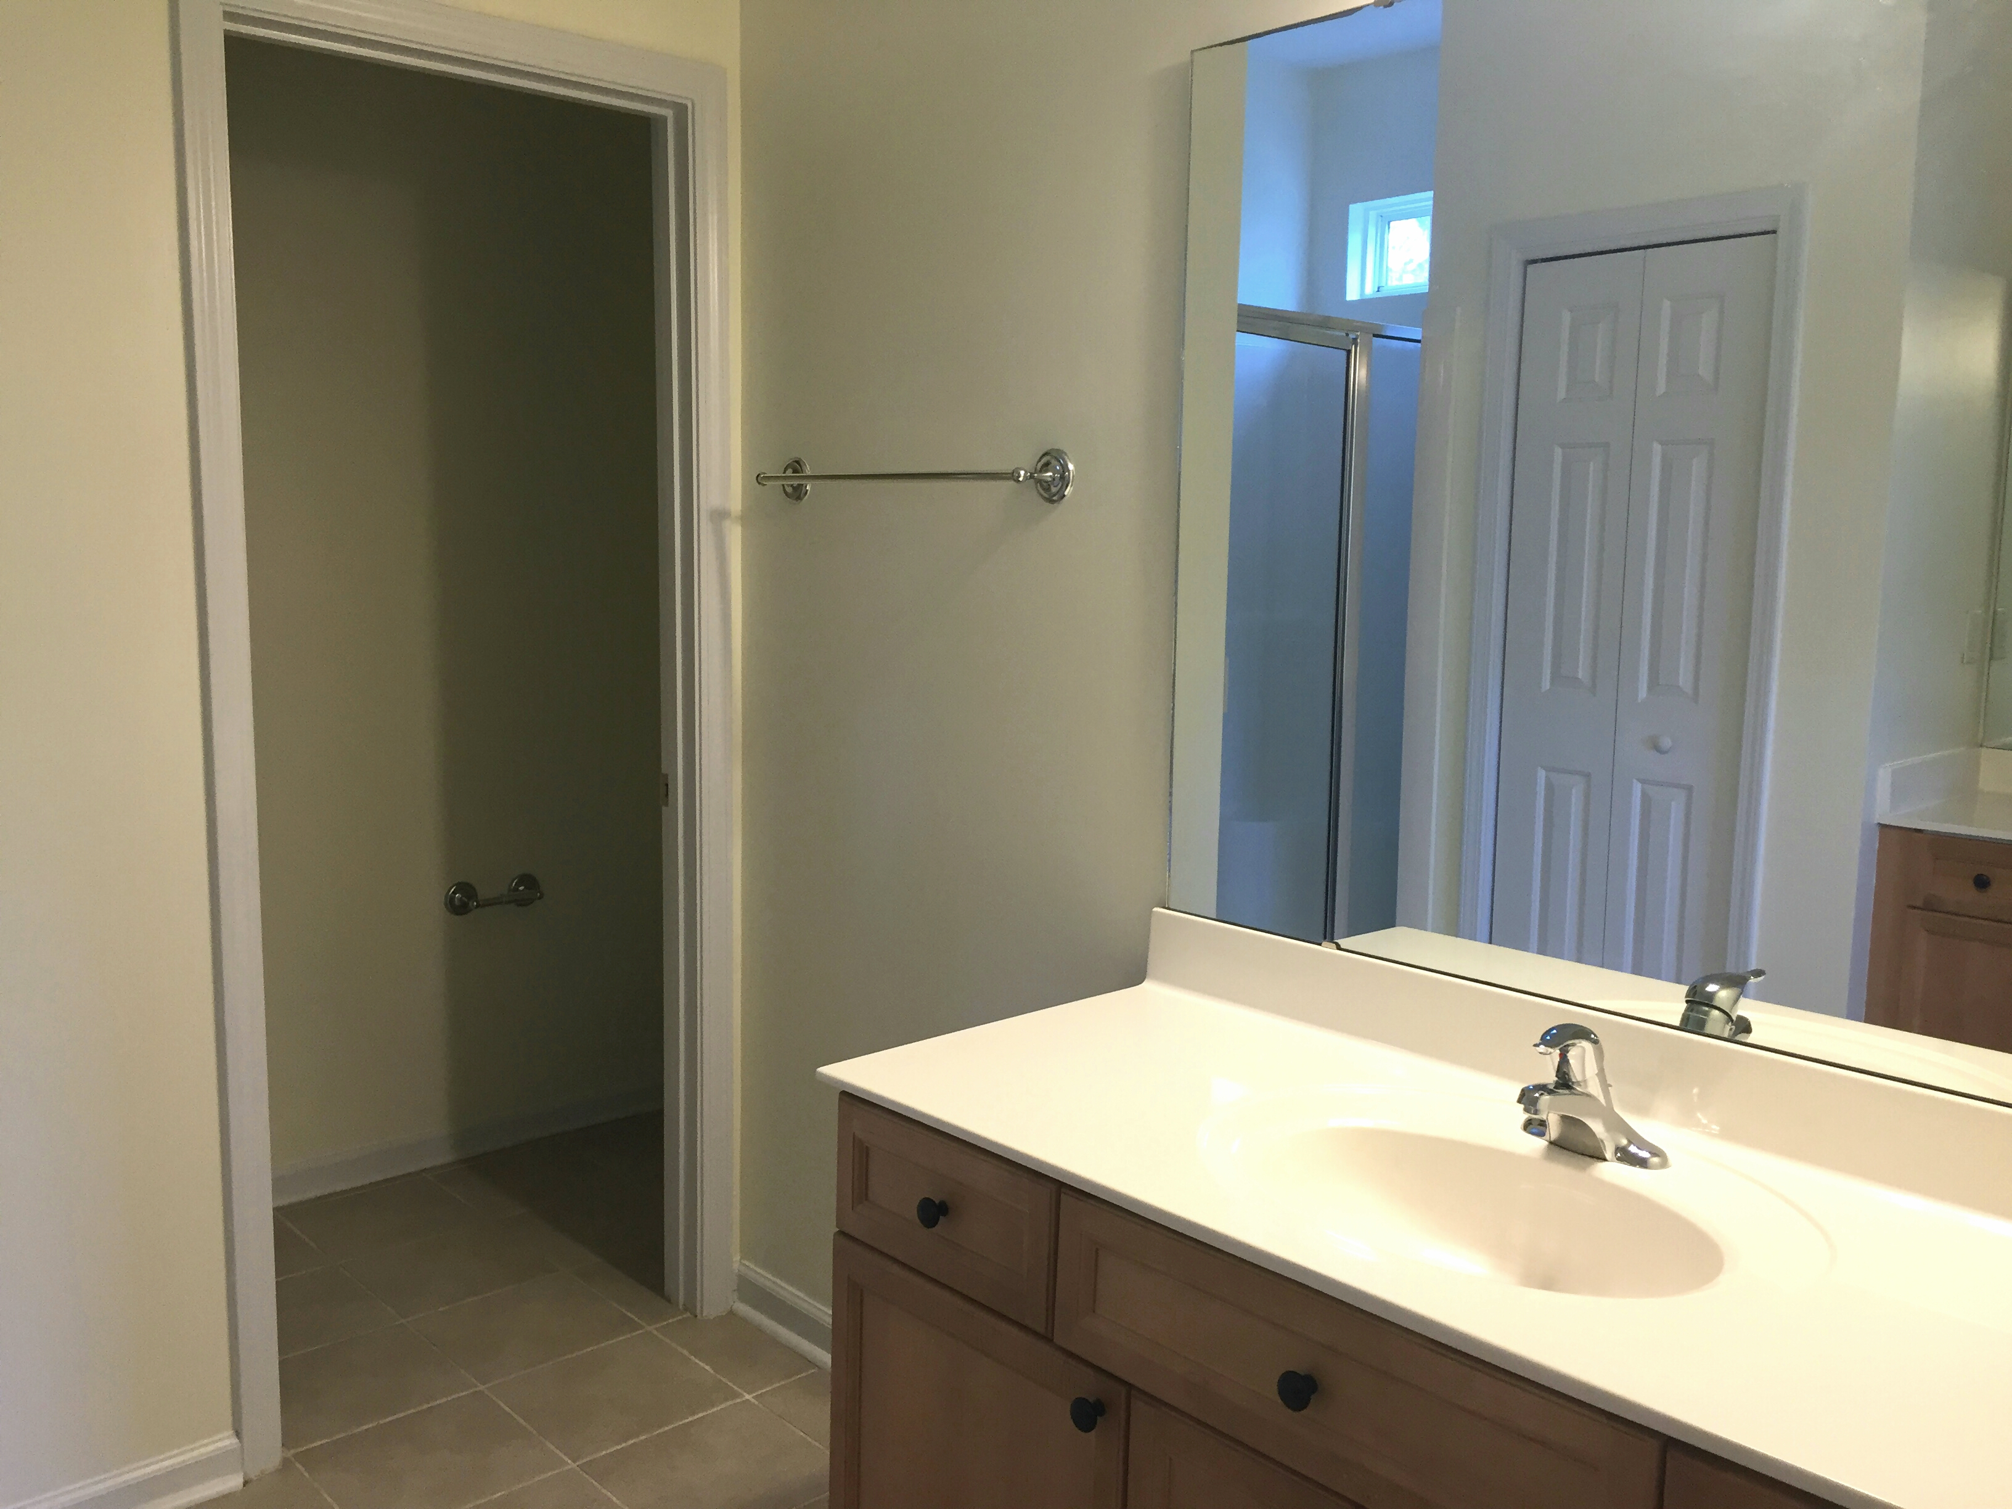
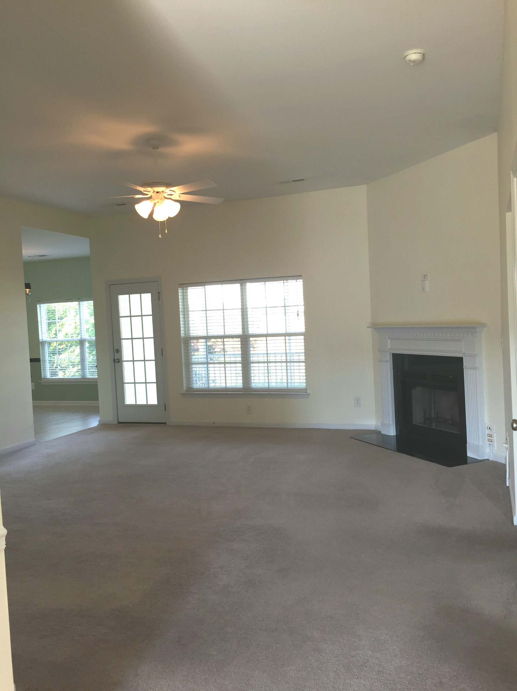
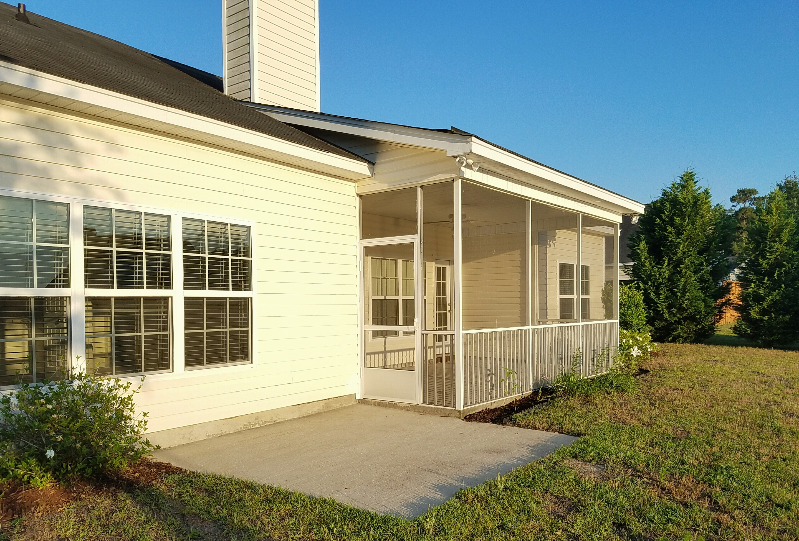
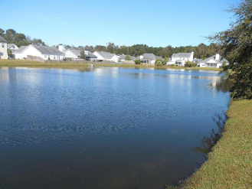


Must See!
Open House
Sat. June 4th 11-2:00
1171 Hammrick Lane
Summertrees · Johns Island · MLS# 16011748 · $257,000
Rodney Hancock
(843) 437-1347
rodneyhancock08@gmail.com
mortgageprofessionalsonline.com
TENANTS HAVE VACATED AND SELLER HAS HOME READY FOR SALE! Don't miss the opportunity to purchase this lovely 3 bedroom 2 bath home on Johns Island in Summertrees. Previously a model home. Loaded with lots of extras. Its a Earth Craft Energy Efficient Home that's on the corner lot of the pond. Highlights - 2 Car Garage, Hardwood floor entry way, Fireplace, Wired for TV above the Fireplace, Silverstone Quartz counter tops, vaulted tray ceiling in the master bedroom, dual his and her sinks in the master bathroom, Over sized closet in the master, ceiling fans in every room, Double sized screened in porch 18 x 10 with an additional 10x 10 patio/slab, all kitchen appliances upgraded. This house can be eligible for 0.5% of the loan amount cash back toward closing costs. Ask me how!
AgentOwned Charleston Group
902 Savannah Hwy
Charleston, SC 29407
Real Estate ● Mortgage
Insurance ● Business Brokerage

