Slide 1
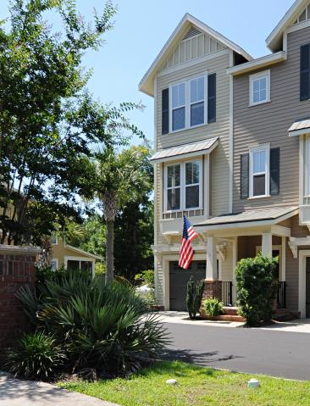
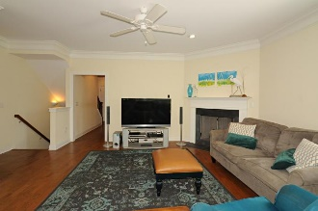
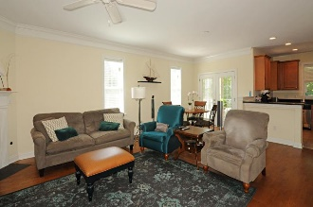
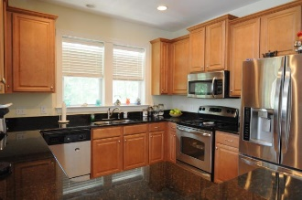
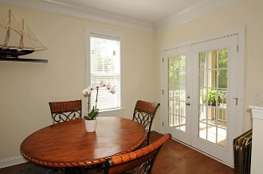
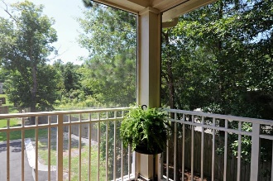
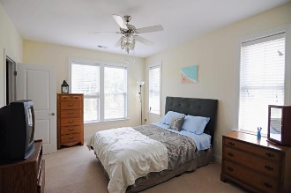
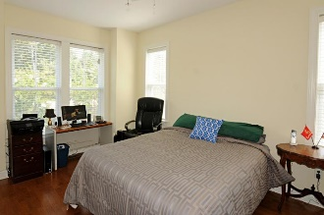
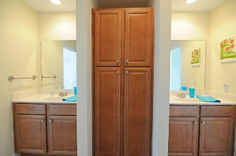
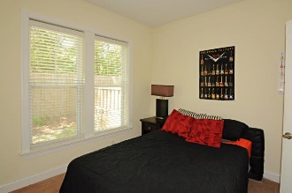
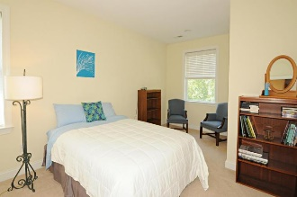


1181 Dingle Road
Royal Palms
Mount Pleasant, SC 29466
MLS# 16016587 · $325,500
4 Bedrooms
2 Full Baths | 2 Half Baths
A Must See!
Loaded with Upgrades!
Just Listed!
This units has hardwood upgrades that the others do not. Best unit in community! Largest floor plan at 2449 square feet.The garage is 45 feet deep and can fit 3 cars. On the first floor in the back is an office/study area (that also could be used as a 4th bedroom), a bathroom, a walk in closet/coat room, and a backyard patio. Up to the next level you enter the living room area, with a gas fireplace. The dining area combines for an entertaining area, with access by double french doors to the screened in porch area. There are 9 foot ceilings on all three floors! The open kitchen has granite counters. The appliances are stainless steel, and 42 inch upgraded cabinets have crown molding on top for that extra touch of class and recessed lighting in the kitchen throughout.
The second floor features the master bedroom with large walk-in closet. Master has dual vanities, bathroom shower is tiled from floor to ceiling and also has a relaxing soaking tub. There are upgraded satin nickel finishes on the hardware. Moving up to the third floor there are two more large bedrooms and a shared full bathroom, plus an extra room for storage or that could be used as another walk-in closet. There are 2 inch blinds on the windows, with 5 inch crown molding in foyer, living and dining area complete the quality of these homes. Seller installed a gutter system 2 yrs ago. ONSITE BOAT STORAGE IS AVAILABLE. This is a secluded and quaint pocket community that is central to nearby shopping and entertainment. HOA is $155 a month and includes roof maintenance, landscaping, termite bonds, power-washing, exterior painting, irrigation, exterior pest control, property management, street maintenance and reserves.
Nikki Jones | nikki@petigruproperties.com | (843) 442-5880
Petigru Properties, Inc · 792 Folly Road Suite 5 · Charleston, SC 29412

