Slide 1
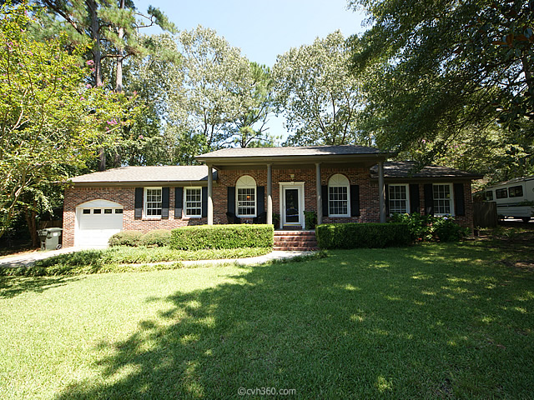
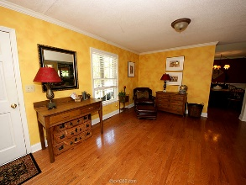
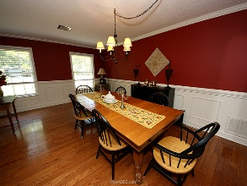
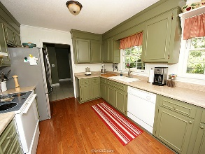
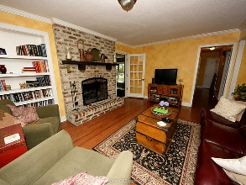
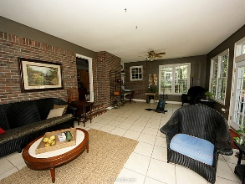
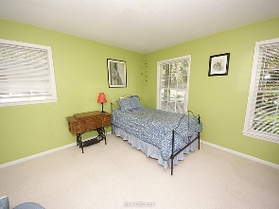
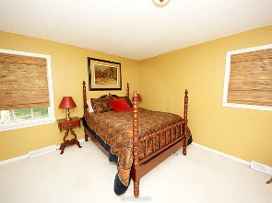
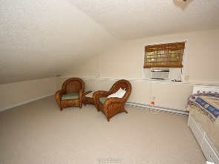
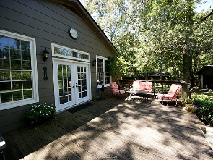
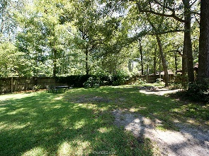

119 Bobwhite Lane Quail Arbor Summerville, SC 29485 MLS# 15021418 $220,000 3 Bedrooms | 2 Baths | 2,475 sf
Open House Lunch ~ Friday, Oct 3 from 11 - 1
Handyman Special… Bring your hard hats!
Back on market… Reduced $10,000!
Looking for a home with personality in a neighborhood that isn't lined with cookie cutter homes? This is it!!!
Lovingly updated and cared for with new roof and HVAC, 1 car attached garage and 1.5 car detached garage, sunroom and deck leading into gorgeous yard with mature trees and shrubs. Amenities include neighborhood pool, tennis court and playpark. Wonderful schools with easy access to shopping and hiways.
Owner has moved and will entertain all reasonable offers. A MUST SEE!!!!!!
Hillary Jones
843-709-4666 hillaryjones67@gmail.com www.agentownedrealty.com
AgentOwned Realty Co. Preferred Group, Inc. | 824 Johnnie Dodds Blvd | Mt Pleasant, SC 29464

