Slide 1
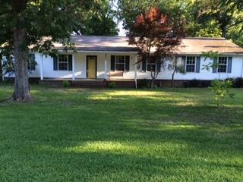
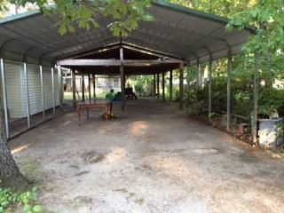
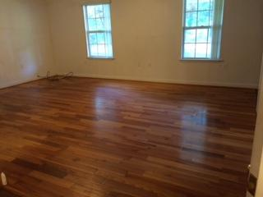
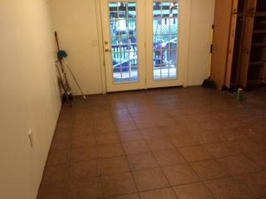
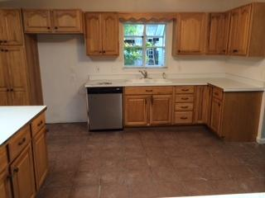
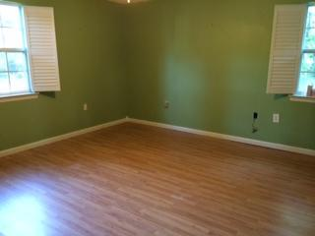
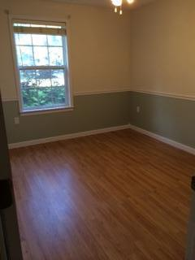
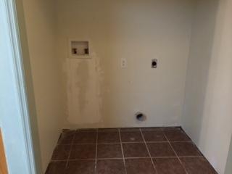
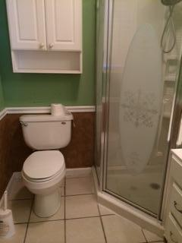
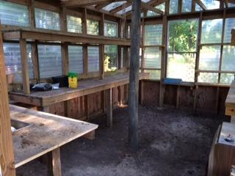

121 Sinkler Avenue
Eutawville, SC 29048 | MLS# 15013717 | $169,500
4 Beds | 3 Baths | 2,232 Square Feet
Huge lake property with 4 bedrooms, 3 bathrooms and plenty of room for your entire family! The master suite has its own entrance and cover porch. This property has over 2200 square feet of living space PLUS it has an outdoor eating area, a green house, a workshop that has heat/air and water, and 2 carports. This property has two wells and two hot water heaters. Property is less than 1 block from Bells Marina, and less than a mile from 2 public boat landings! Come enjoy the lake life!!!
Carla C Davis
Mobile - (843) 437-4873
gaweber@tds.net
AgentOwned Premiere Group
141 A N. Main Street
Summerville, SC 29483

