Slide 1
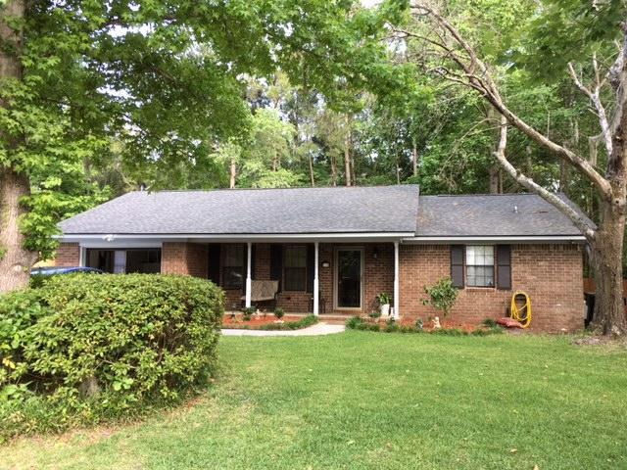
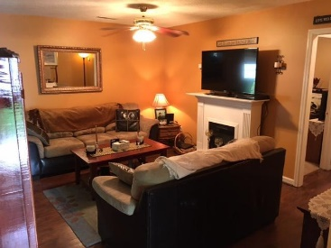
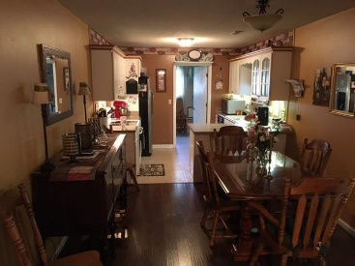
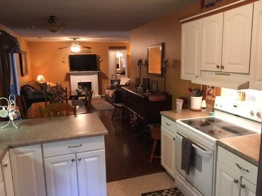
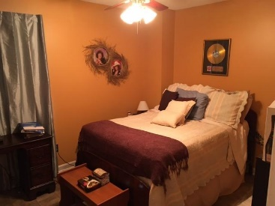
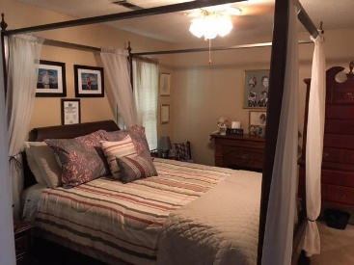
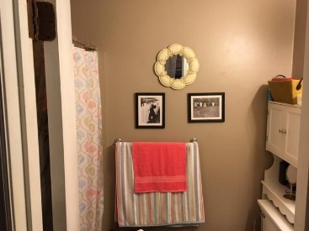
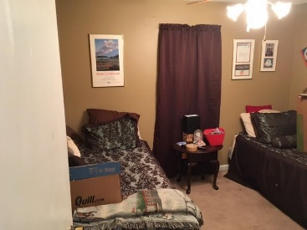
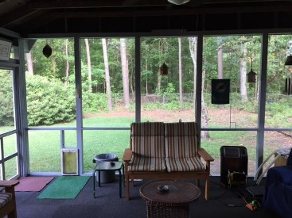

Back on the Market!
Great Price $139,900
$5,000 Buyer's Agent Bonus at Closing!
121 Surrey Drive
Tramway ~ Summerville, SC 29483
MLS# 16013563 ~ $139,900
Buyer just released from contract!
Totally remodeled brick home on huge wooded lot close to I-26.Almost everything has been replaced in the last three years. Beautiful new laminate floors open into a huge family room. Enjoy all year round in the huge screen porch off the family room. Conveniently located to everything.
Home is 'Sold As Is' and is priced to move quickly!
Paul Welsh
(843) 343-9799
paulkwelsh@gmail.com
AgentOwned Charleston Group
902 Savannah Hwy
Charleston, SC 29407

