Slide 1

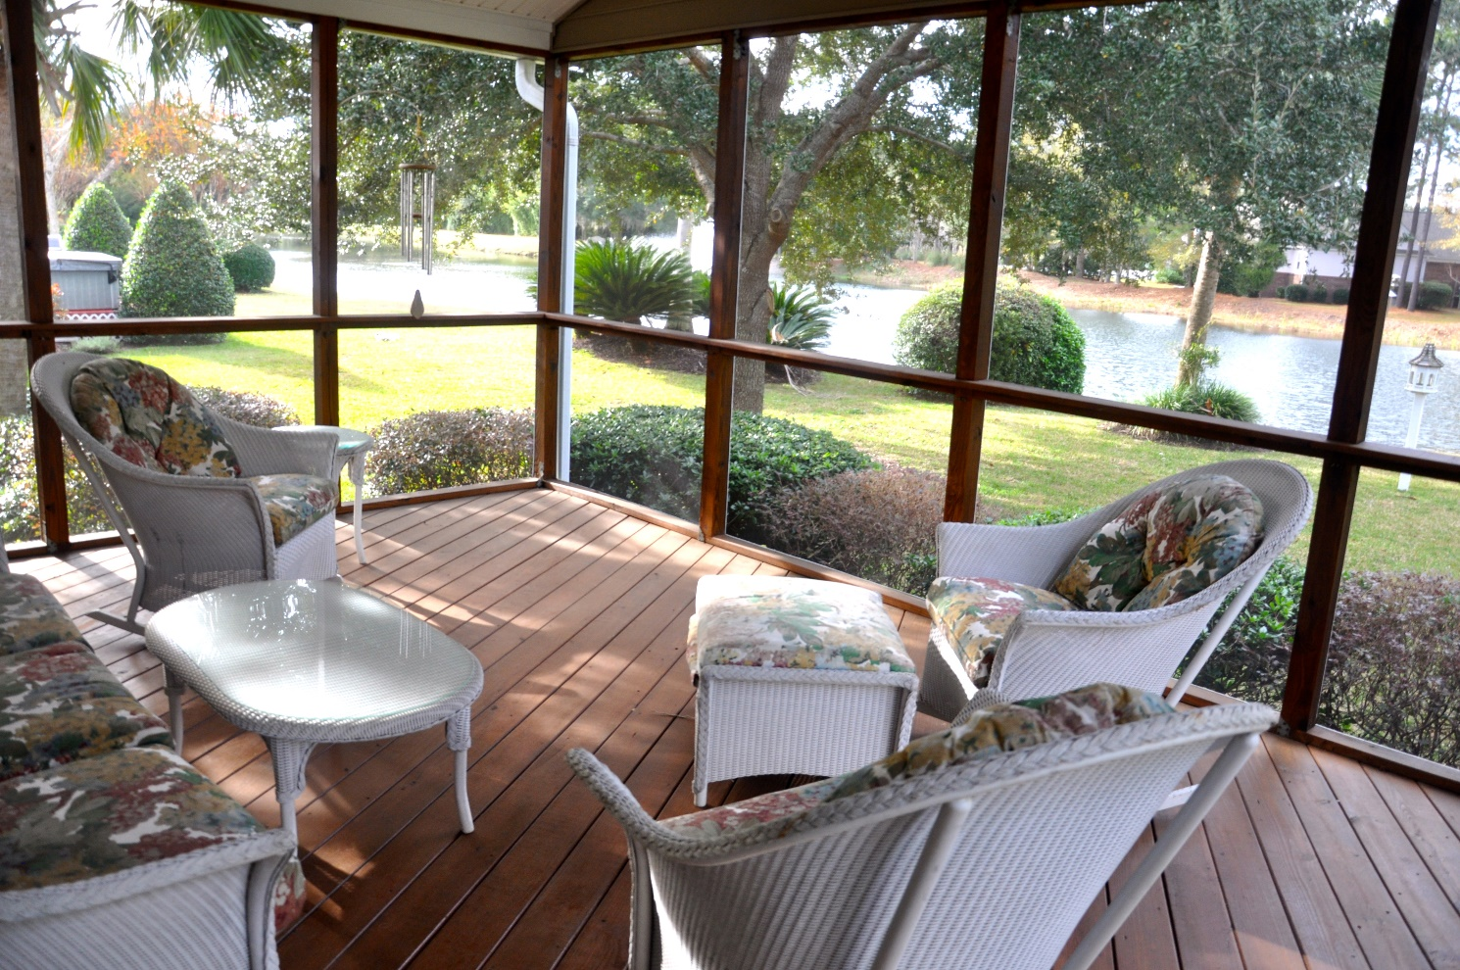
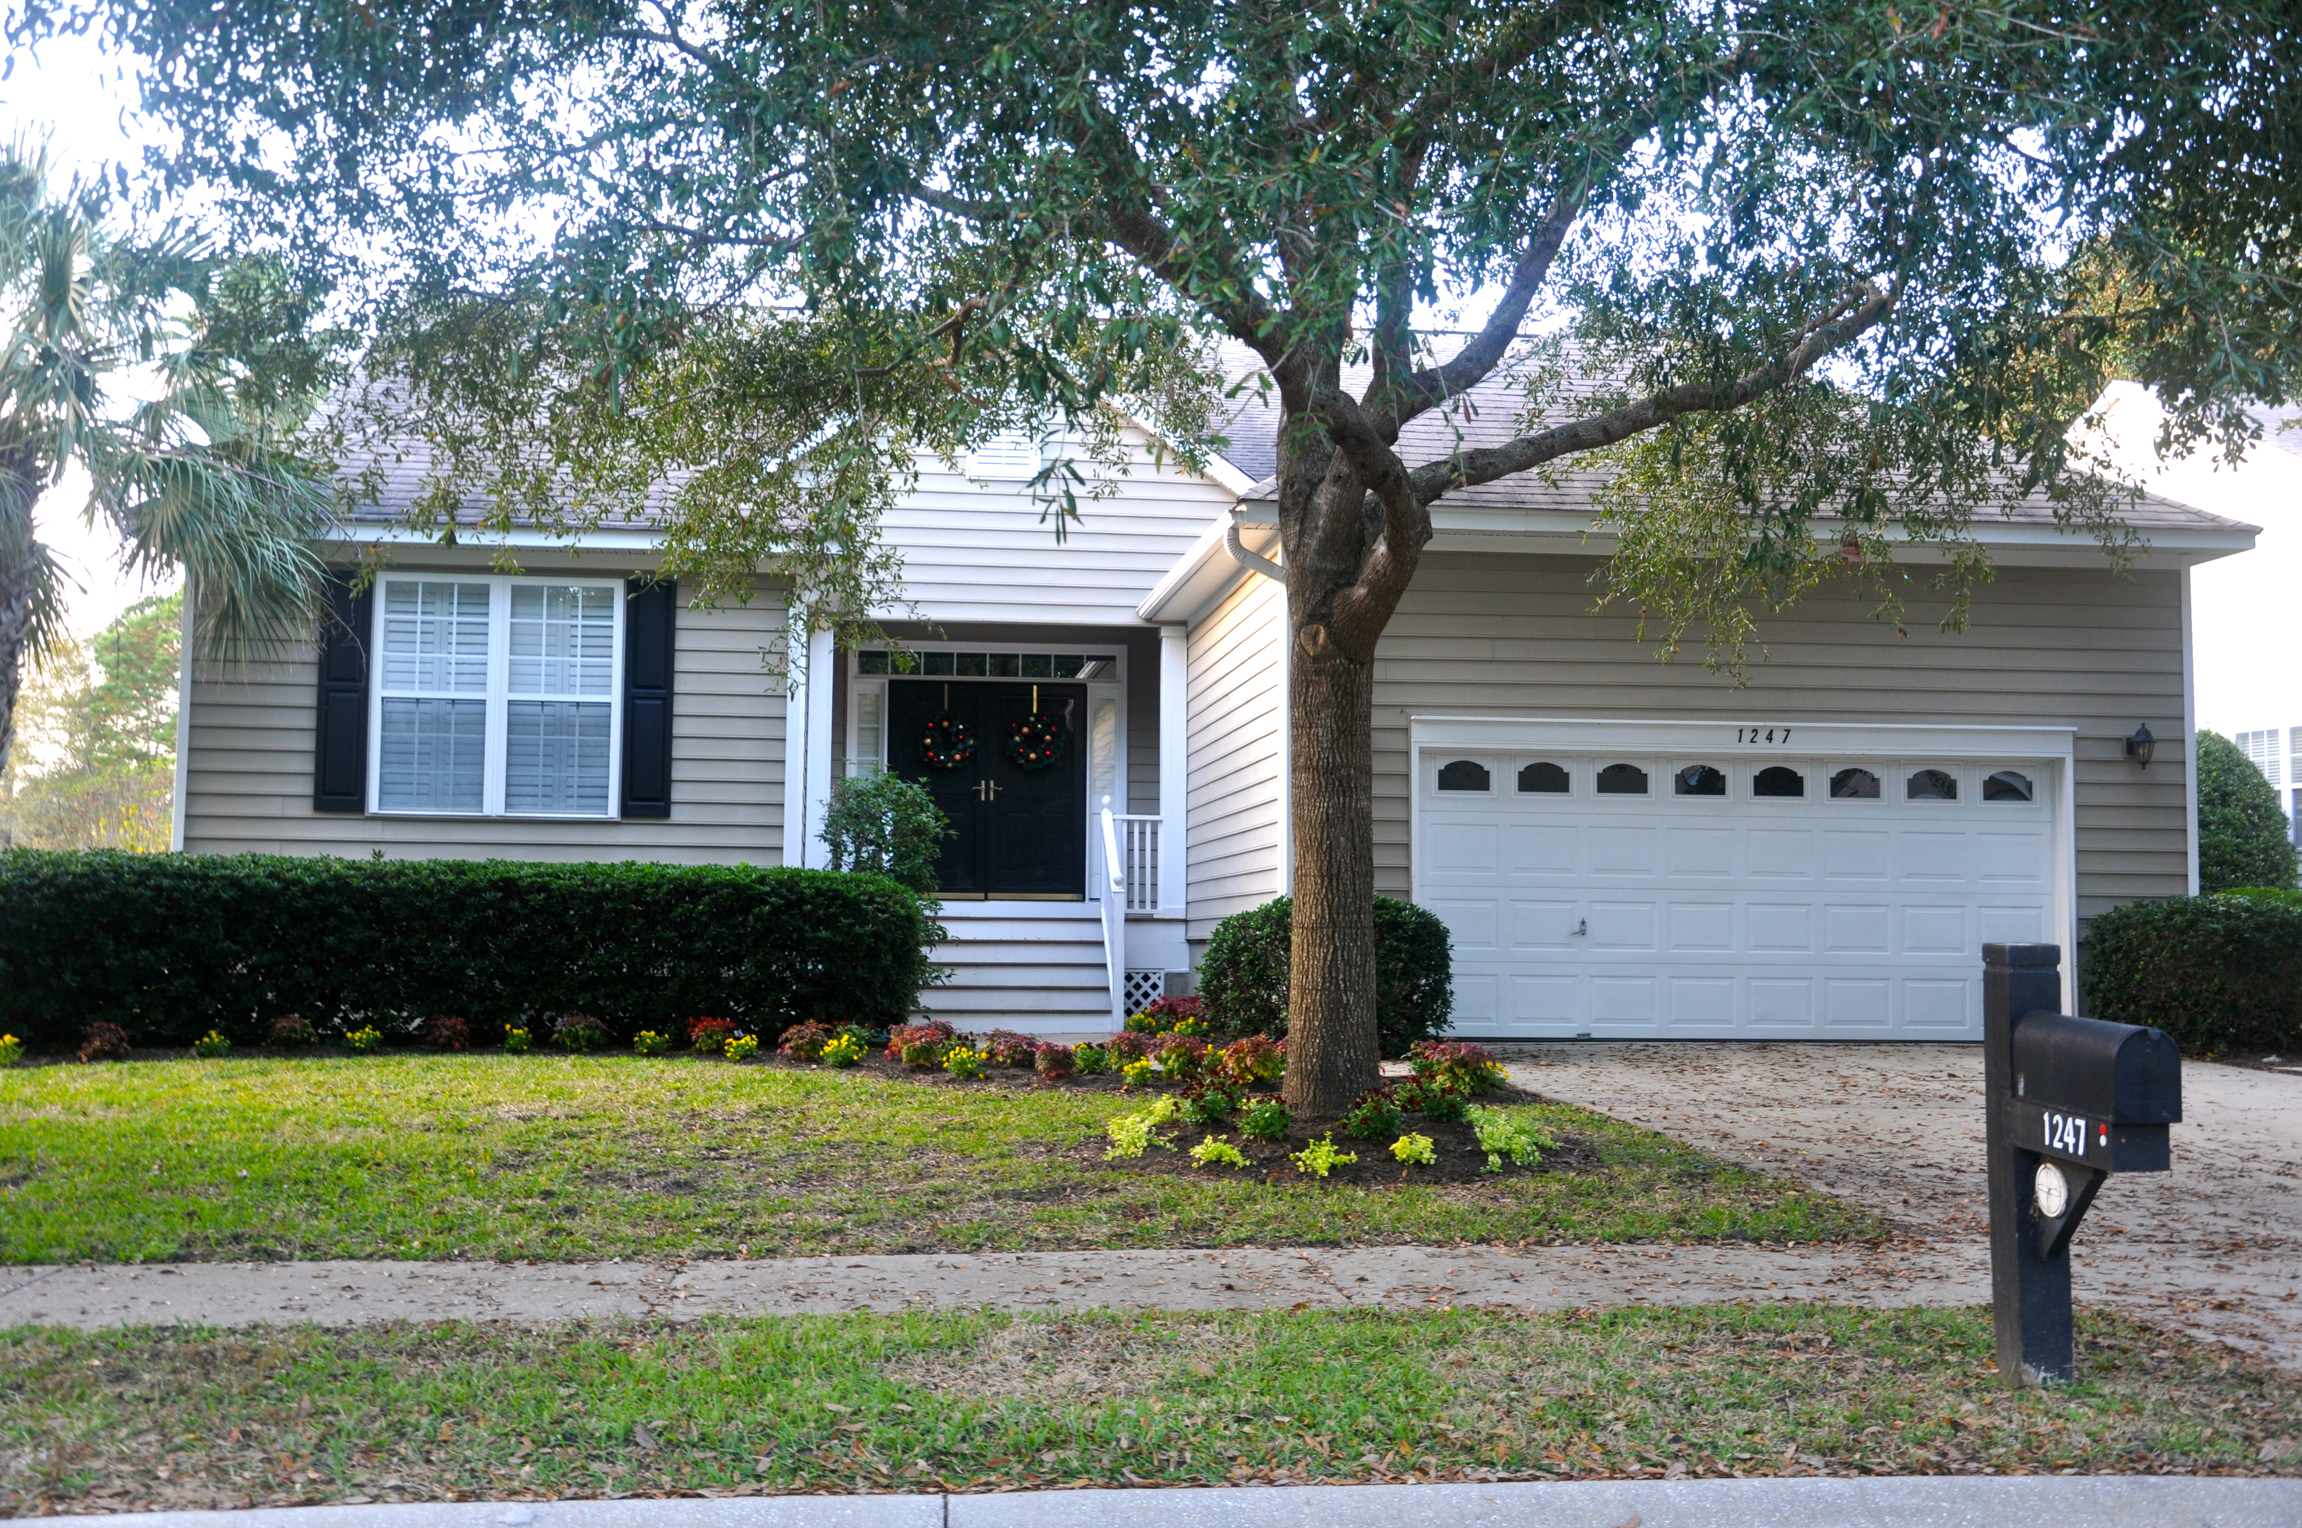
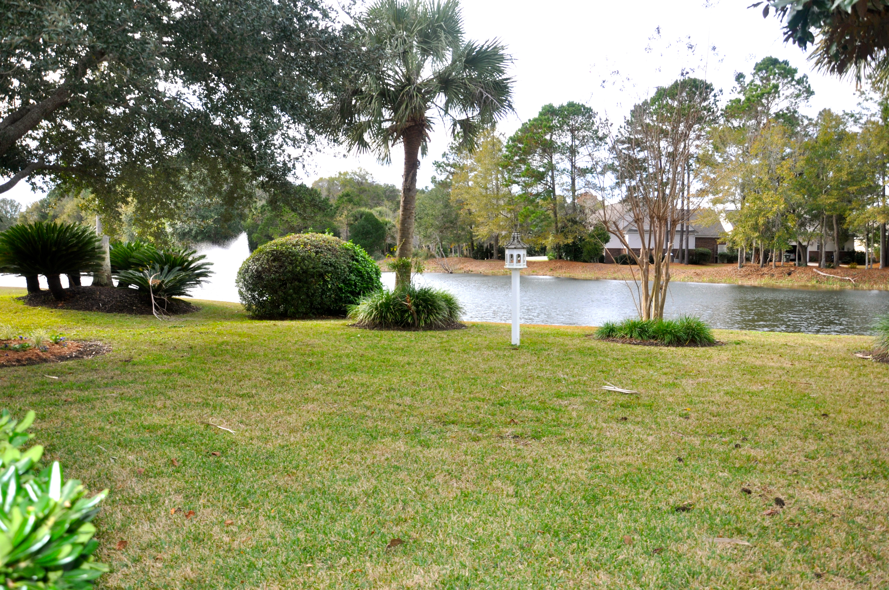
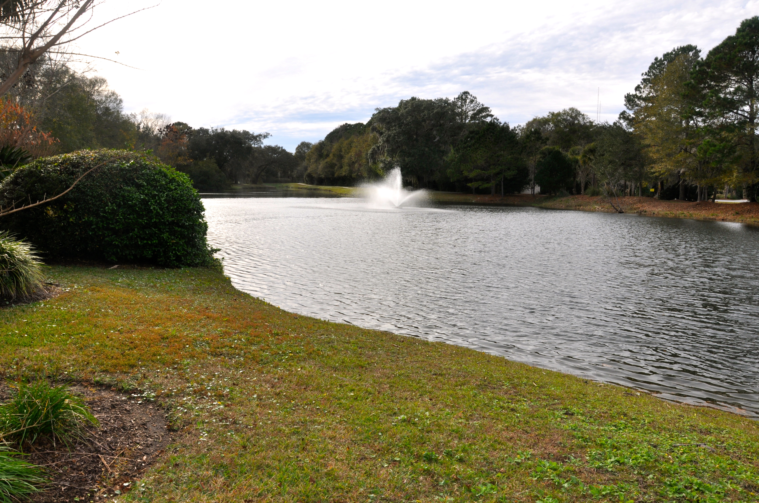
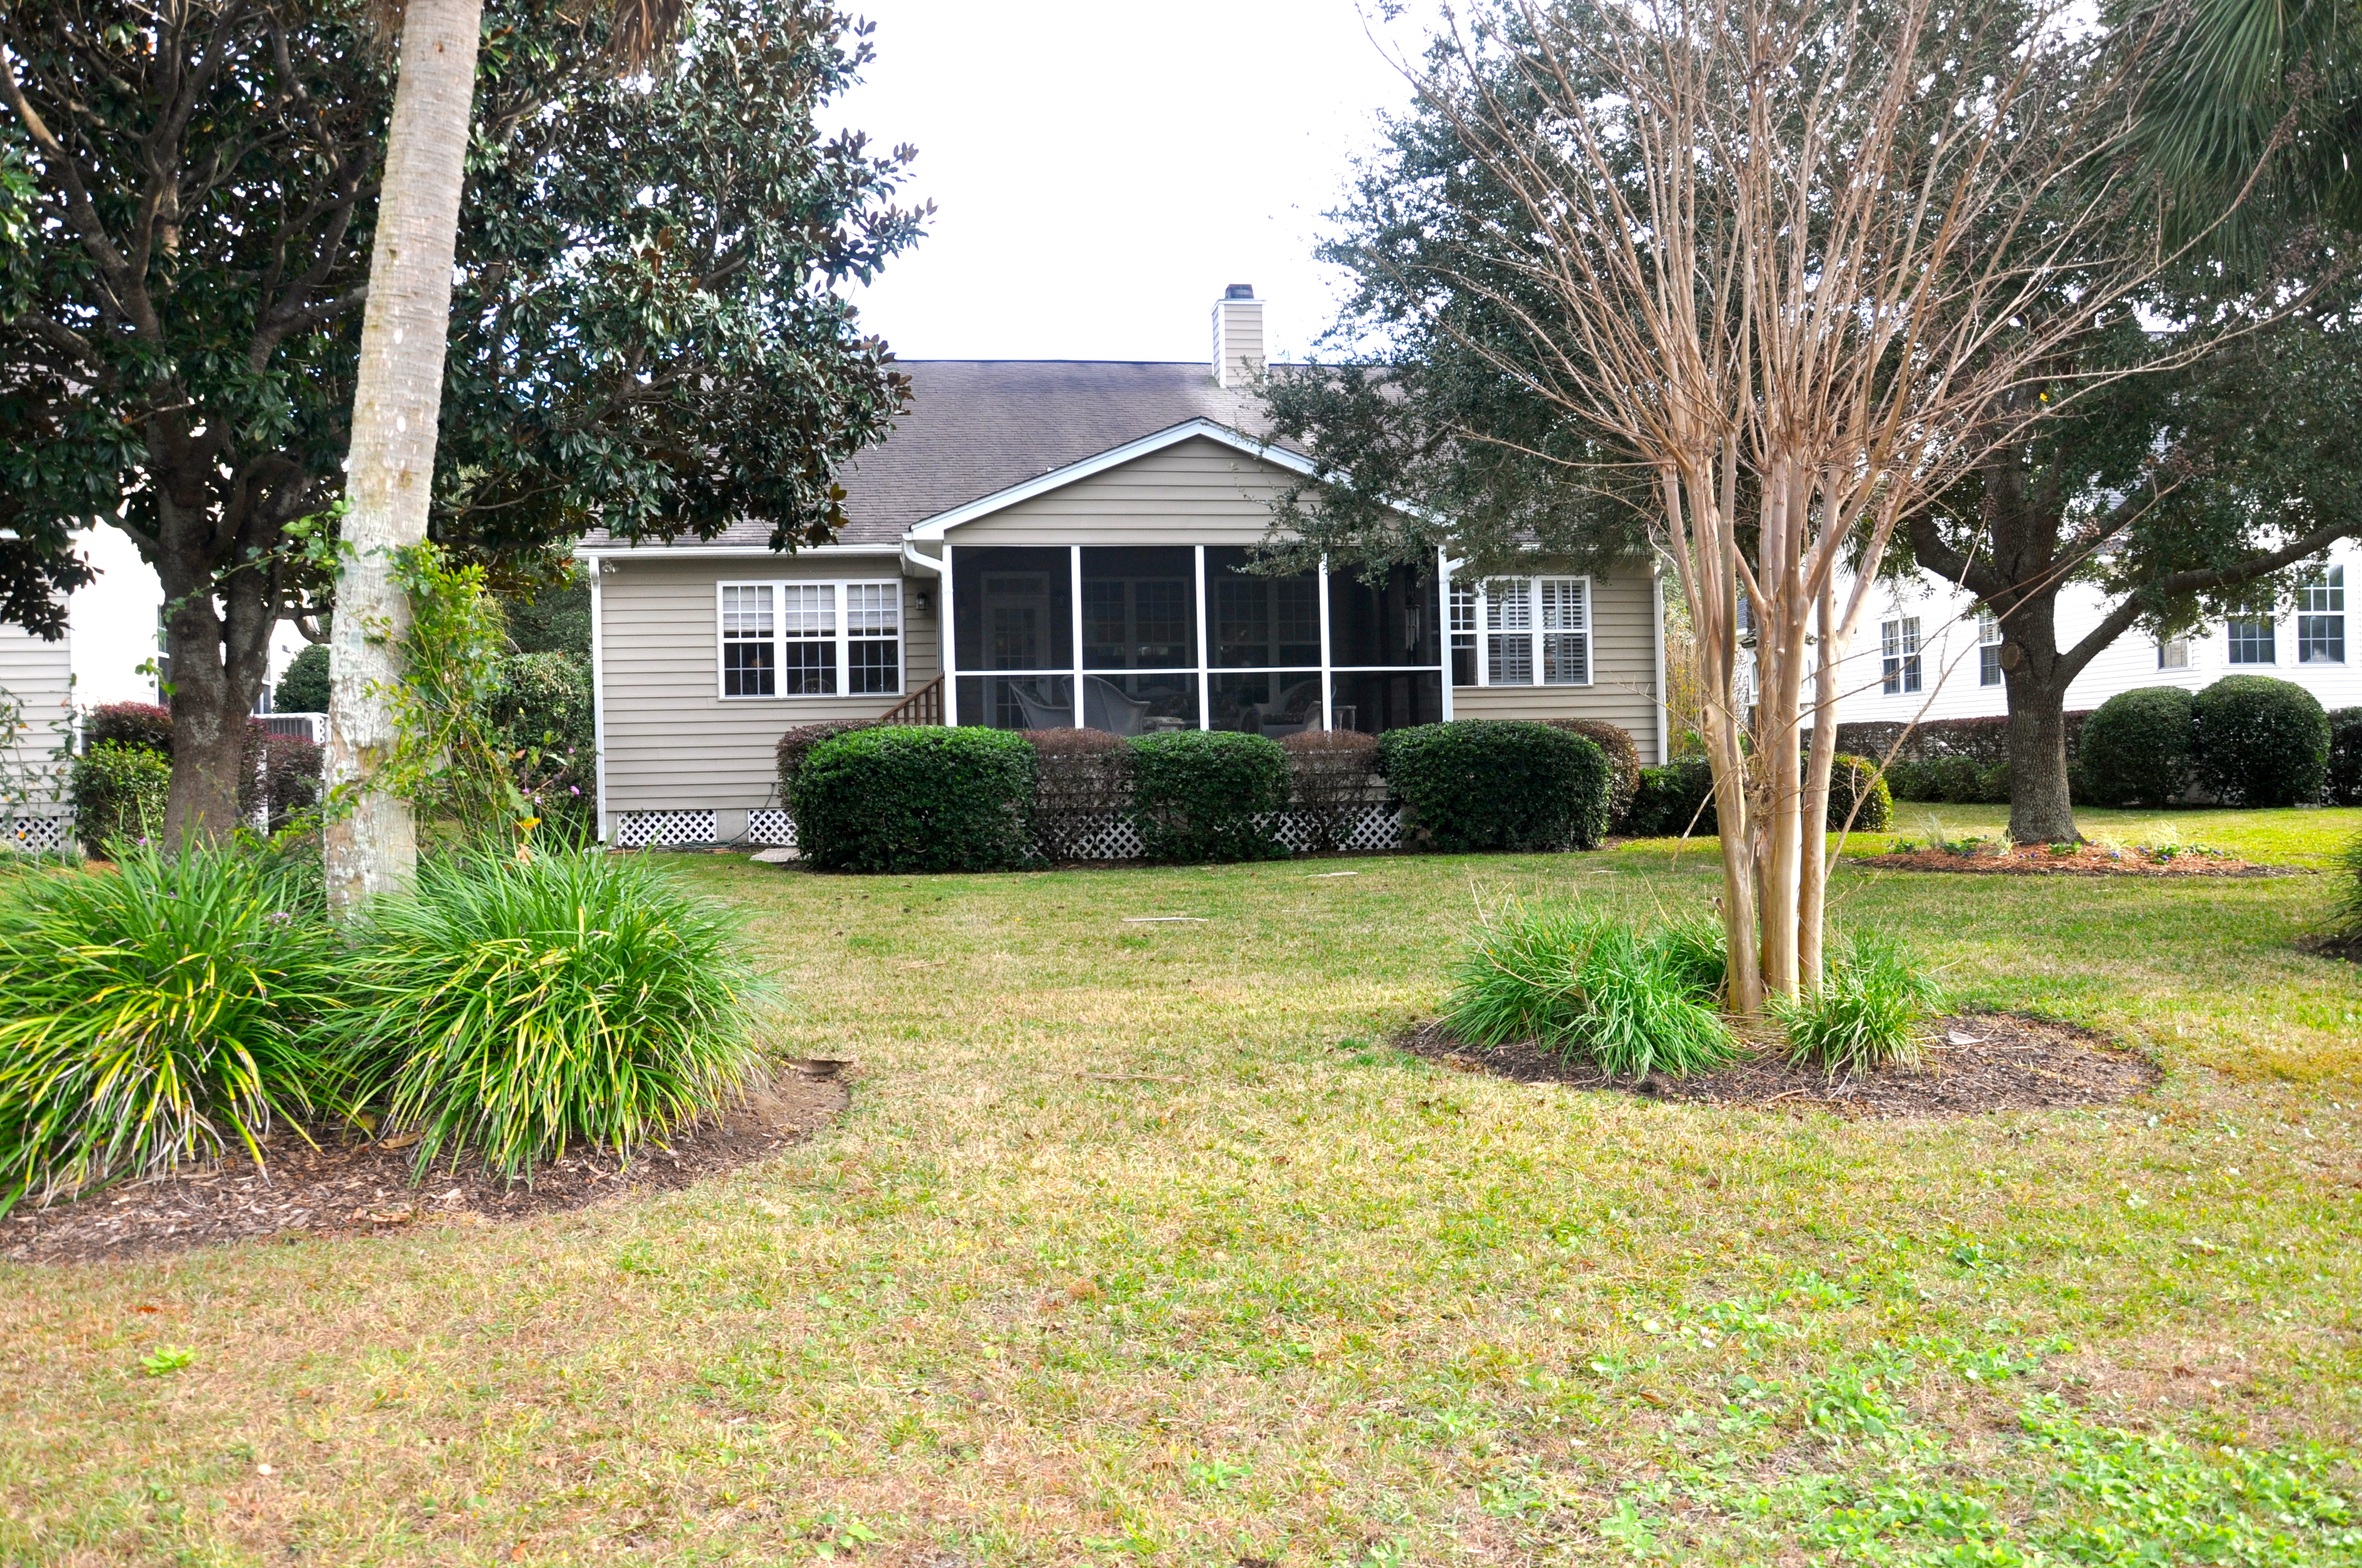

1247 Palmetto Peninsula Drive
Seaside Farms
Mount Pleasant, SC 29464
MLS# 15031264
$569,900
Open House Sunday, January 10 from 2-5pm
Waterfront home w/ open, airy, single story living in one of Mt Pleasant's premier communities where LOCATION, LOCATION, LOCATION offers the lifestyle of being walking distance to fine dining and shopping and just minutes away from theaters and the beautiful beaches of Isle of Palms and Sullivan's Island! The great room w/ fireplace and built-in shelving is expansive and open to the kitchen and dining area.
Relax in the separate den/sunroom and enjoy views of the water! The screened-in porch behind home offers additional space to take advantage of the serenity the water brings. The eat-in kitchen offers plenty of cabinet storage with separate island and pantry. Brand new hardwood floors just installed throughout!
Dunes Properties of Mt. Pleasant
1510 N Hwy 17
Mt. Pleasant, SC 29464 www.dunesproperties.com
Donna Webb
Mobile - (843) 469-1110
dwebb@dunesproperties.com

